Slide 1

Virtual piano using Raspberry pi
DEPARTMENT OF:
ELECTRONICS AND COMMUNICATION ENGINEERING

Slide 2
Virtual piano using Raspberry pi
Project Stage-2
(Review-2)
Presented By:
N.SAI SRI DHARANI (20AG1A0448)
N.YASHWANTH (20AG1A04446)
B.BALAJI (20AG1A0404)
Under the guidance of :
Mr. R. NARENDER
(Assistant Professor)

Slide 3
Abstract:
Pianos are large instruments that cannot be carried everywhere.
Even electric pianos need to be carried in a large bag and are prone to damage in travelling.
So here we propose a portable virtual piano that just uses semi transparent plastic sheet that can be carried and does not have any electronic components in it.
We use a raspberry pi attached to a camera along with the plastic sheet to make a virtual piano

Slide 4
Components
Hardware:
Raspberry Pico
12V
Touch Modules
Push Button
16x2 LCD Display
DF Mini Player
Speaker
SD Card
Software:
Arduino/Thonny IDE

Slide 5
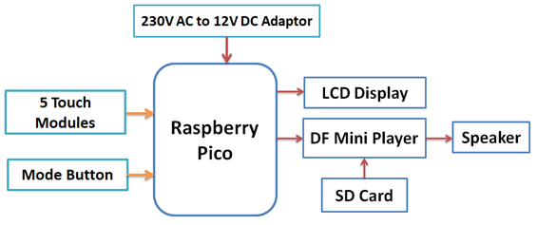
Block Diagram :

Slide 6
Components :
Raspberry Pico
The main microcontroller board that controls the entire project.
It provides GPIO pins for interfacing with other components and processing capabilities for running your code.
12V Power Supply
Provides power to the Raspberry Pi Pico and other components in the project.
Touch Modules
These modules serve as the keys of your virtual piano.
Capacitive touch modules are commonly used for sensing touch inputs.

Slide 7
Push Button
switching between modes
16x2 LCD Display
Can display information such as selected mode, current octave, or song titles.
DF Mini Player
A mini audio player module capable of playing audio files from an SD card.
Speaker
Outputs sound generated by the virtual piano or music played by the DF Mini Player.
SD Card
Stores audio files for playback by the DF Mini Player.
Provides additional storage for project data.

Slide 8
Advantages
Portability
Customization
Cost-Effective
Compact size
Accesability
Low power consumption

Slide 9
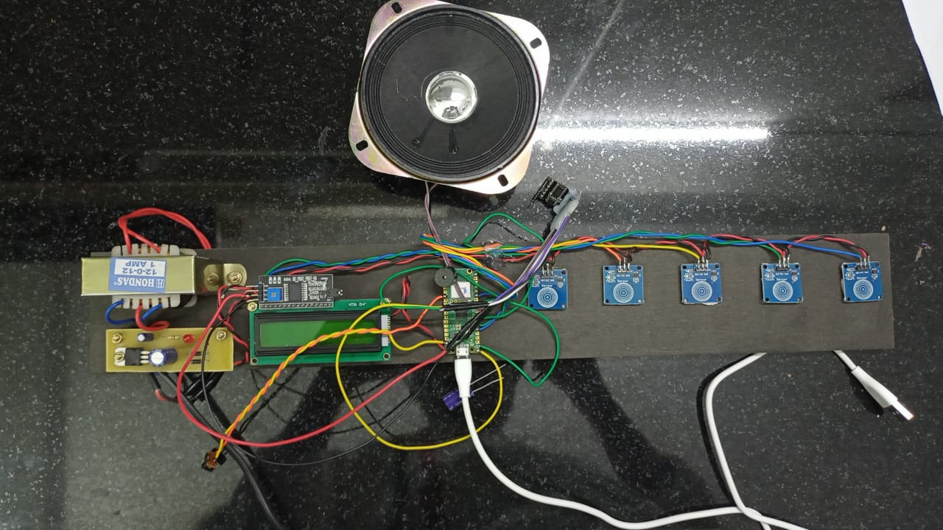
WORKING MODULE

Slide 10


